Slide 1
Manage Mac
March 2012
MMSP

Slide 2
What is Manage Mac?
A system developed by MM to MANAGE A380 kits.
Features include:
  Parts receipt
  Parts issuance and return
  Parts transfer
  Parts request

Slide 3
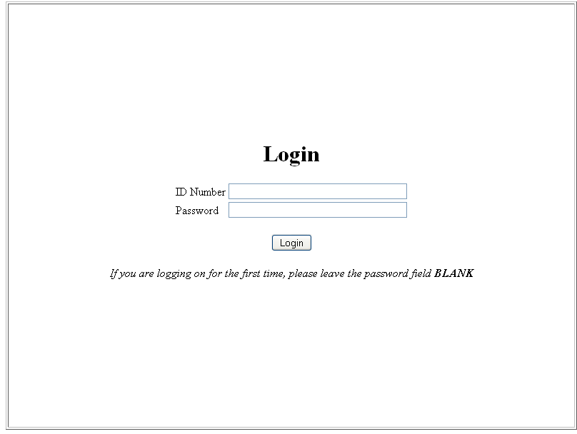
Login
Go to http://procurement/a380

Slide 4
Login
Login using your ID NUMBER.
Upon login, you will automatically be sent to Parts Request page.
If logging in for the 1st time, leave the password field blank.

Slide 5
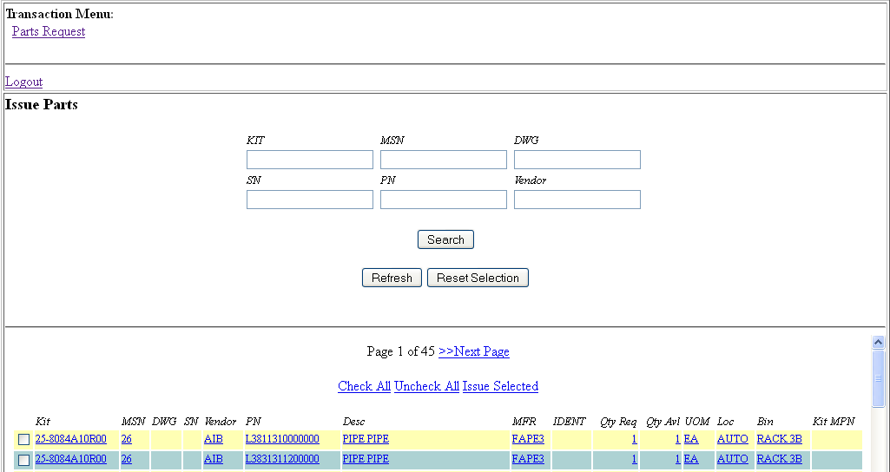
Part Request

Slide 6
Part Request
Features:
  Display all parts available for withdrawal.
  Search for part by PN, MSN, Drawing #, Kit PN, Vendor, or a combination.
  Request for part.

Slide 7
Creating Part Request
3 methods:
  Click on individual parts
  Select multiple parts by ticking the checkbox before each part and clicking Request Selected
  Download the entire list by clicking Download as CSV file and removing unwanted parts

Slide 8
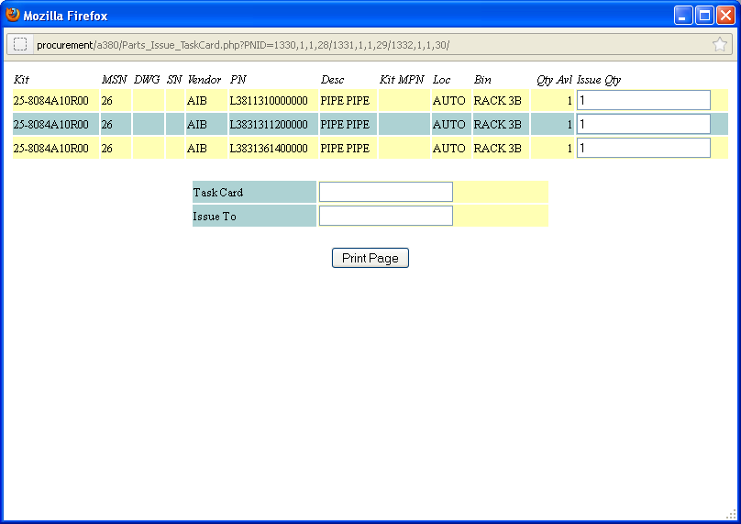
Creating Part Request

Slide 9
Creating Part Request
New window will be displayed.
Encode the required QTY for each PN, the TASKCARD and your ID Number.
Click Print Page.

Slide 10
Limitations
Parts from different pages cannot be issued together.
  If you need several parts from different pages, we suggest you download the list instead.
Parts are NOT reserved to you.
  Please contact MSU if a part you need has already been withdrawn by another person.

